Slide 2
Declaration Map
Claiborne
Union
Morehouse
West Carroll
Presidential Declaration
Individual Assistance – Includes all SBA loan programs to residents and businesses in declared parishes/tribal nations
Public Assistance – Includes SBA loans to certain private nonprofits of a governmental nature declared parishes/tribal nations
Caddo
Webster
East
Carroll
Bossier
Lincoln
Ouachita
Richland
Madison
Bienville
Jackson
Red
River
Caldwell
Franklin
De Soto
Winn
Tensas
Natchitoches
La Salle
Catahoula
Sabine
Grant
Concordia
Primary IA Parishes
Rapides
Vernon
Avoyelles
Contiguous Parishes
West Feliciana
East Feliciana
Saint. Helena
Washington
Beauregard
Allen
Evangeline
Pointe
Coupee
East
Baton
Rouge
Tangi-
pahoa
St. Landry
West
Baton
Rouge
Livingston
St. Tammany
Calcasieu
Jefferson
Davis
Acadia
St. Martin
Iberville
Lafayette
Ascension
St. John
Baptist
St.
James
Orleans
Iberia
Assump-
tion
St. Bernard
Cameron
Vermilion
St.
Martin
St. Charles
St.
Mary
Jefferson
Lafourche
Plaquemines
Terrebonne

Slide 3
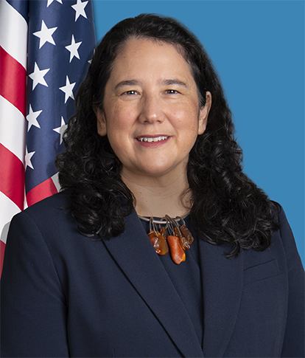
SBA’s Role in Disaster Recovery for
Federal Disaster Declarations
SBA disaster loans are the primary source of federal assistance to help private property owners pay for disaster losses not covered by insurance or other recoveries.
SBA offers low-interest federal loans to businesses of all sizes, private nonprofit organizations, homeowners and renters.
SBA Administrator
Isabella Casillas Guzman

Slide 4
Federal Role of SBA Loans in Long-Term Recovery
Disaster losses are unexpected and create a financial hardship for businesses and residents.
By providing affordable disaster assistance in the form of loans, SBA helps reduce federal disaster costs compared to other forms of assistance, such as grants, CDBG-DR funding, or HUD assistance.
These loans require borrowers to maintain appropriate hazard and flood insurance, reducing the need for future federal assistance.
SBA’s disaster loans are a critical source of economic stimulus in disaster-ravaged communities and help spur employment and stabilize tax bases for local governments.
4

Slide 5
Making Recovery Affordable
The Small Business Act and additional disaster laws provide SBA tools to make disaster loans affordable:
Low-interest (below market) rates -set quarterly
Affordable long terms (either 15 or 30 years)
Payments are based on borrower’s ability to pay
In certain circumstances, borrowers may be able to refinance existing liens or mortgages, or may use an SBA loan to relocate (cases have specific criteria and limits)
(NOTE: Loan amounts and terms are set by SBA and based on each applicant’s financial condition)

Slide 6
Loan Eligibility Restrictions
Only uncompensated losses (disaster losses not compensated by insurance or other recoveries such as FEMA grants, reimbursement by another party, settlement of a lawsuit, etc.) are eligible.
Applicants are not eligible if they have not complied with the terms of previous SBA loan agreements or other Federal obligations (e.g., failure to maintain required insurance, court-ordered child support, student loans, or Federal Income Tax filing requirements).

Slide 8
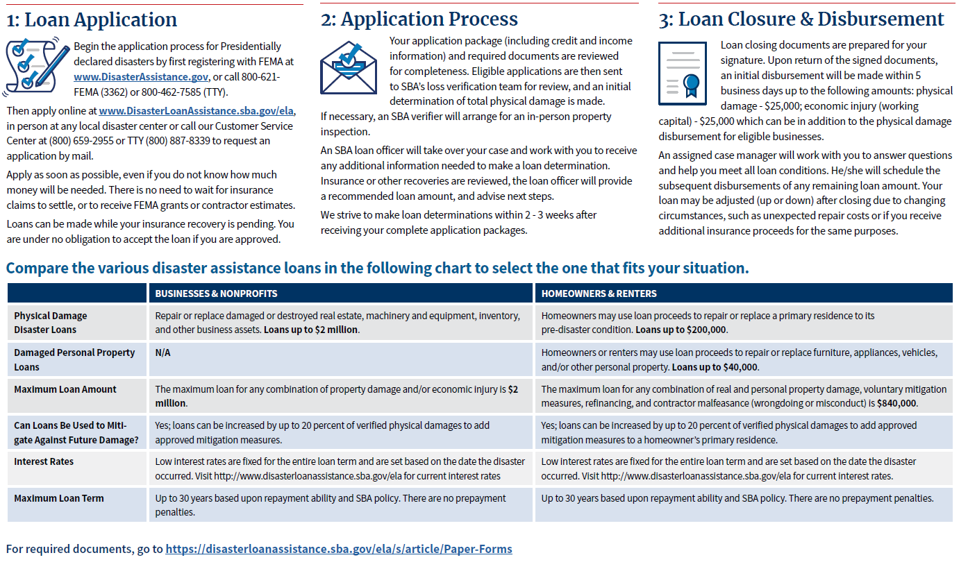

Slide 10
The Importance of partnering with SBA
SBA partners with a wide range of federal and local agencies to assist communities’ economic recovery following disasters.
These partnerships:
Provide small businesses with important information on federal financial resources to rebuild and have access to working capital after a declared disaster.
Serve as vital partners in promoting preparedness and disaster mitigation.
Women’s Business Centers

Slide 11
Role of SBA Resource Partners
Consulting provided by SBA’s Resource Partners is a vital form of disaster assistance and helps businesses:
Successfully stay in operation.
Develop operational, financial and marketing plans.
Consider alternative sources of revenue.
Identify ways to reduce costs.
Update management and technical services.
Women’s Business Centers

Slide 12
Counselors Work Together with SBA to Assist Applicants
SBA refers declined business applicants to
SBDC Business Counselors
When SBA is unable to approve a business loan application due to lack of repayment, unsatisfactory credit history or insufficient information, SBA directs the applicant to a Small Business Development Center (SBDC) as a resource for other help and support.
SBA’s decline letter includes an SBDC referral.
SBA offers applicants who are declined 6 months to request reconsideration for a disaster loan. SBDC Counselors can assist applicants when they request reconsideration.
SBDCs can guide applicants to other resources that may be available. Counseling services are generally free of charge.

Slide 13
Small Business Losses in Disaster
Source: Insurance Institute for Business and Home Safety

Slide 14
Stay Connected SBA Links & Contacts
Subscribe to SBA’s e-newsletter: www.sba.gov/updates
Follow SBA on Twitter: @SBAgov
Follow on Instagram: www.instagram.com/sbagov/
Email: disastercustomerservice@sba.gov
Call: (800) 659-2955
www.sba.gov/relief - all economic aid options
www.sba.gov/ppp - Paycheck Protection Program
www.sba.gov/eidl - Economic Injury Disaster Loan & Payment
www.sba.gov/svogrant - Shuttered Venue Operators Grant
www.sba.gov/rrf - Restaurant Revitalization Fund

